Slide 1
AUTOMATE CLEAN
Large-Scale Dust Cleaning with Robotic Technology
GE19612 - PROFESSIONAL READINESS FOR INNOVATION, EMPLOYABILITY AND ENTREPRENEURSHIP
Sabarimani S 210701218,
Sangthtamil S 210701228,
Sreena R 210701256,
Computer Science and Engineering.

Slide 2
Problem Statement
The problem statement for the "Automate Clean" project is to develop an autonomous robotic cleaning system that integrates green technology and IoT capabilities to efficiently and safely clean large surface areas, particularly in hazardous environments. This system aims to reduce human labor, minimize environmental impact, and enhance operational efficiency through advanced robotic and digital technologies.

Slide 3
Abstract
The project “Automate Clean”, a large-scale dust cleaning through the integration of robotic technology. Traditional methods of cleaning expansive areas often suffer from inefficiencies, labor intensiveness, and limited coverage.The goal of designing a dust cleaning robot using embedded systems is to clean the floor automatically using a robot that can work in hazardous environments without the assistance of people, to construct a floor cleaning robot without a driver, and to develop an autonomous robotics system that uses the internet of things. It is typically used when large areas need to be cleaned with few obstructions.The harmful radiations, chemicals, air pollution, and other factors might cause a man to become ill or perhaps die at places like nuclear facilities or chemical industries. Therefore, this robot can be used there to efficiently navigate and cleans large surface areas with unparalleled precision and effectiveness.
.

Slide 4
Objective
The system aim to achieve the following objectives:
Designing and building a robotic cleaning system with embedded systems.
Ensuring the robot can autonomously navigate and clean large areas.
Integrating IoT for remote monitoring and control.
Enhancing safety by minimizing human exposure to hazardous environments.
Reducing environmental impact through efficient and sustainable cleaning practices.

Slide 5
Existing System
Traditional cleaning strategies for huge surfaces frequently depend on manual labor, which includes laborers utilizing apparatuses such as brooms, mops, and scrubbers.
Semi-Automatic machines, such as ride-on floor scrubbers and sweepers, combine human operation with mechanized cleaning devices.They are more proficient than manual strategies and cover bigger zones with less physical effort.
These strategies are time-consuming, and physically demanding. They moreover challenges in terms of productivity and consistency, particularly in dangerous environments.

Slide 6
Proposed System
The proposed system, "Automate Clean," builds on existing cleaning frameworks by independent navigation, IoT network, and upgraded security highlights to address the confinements of manual, semi-automatic cleaners.The highlight of the proposed framework is its IoT network, encouraged through the Blynk library and app. This integration permits for real-time checking, further control, and information examination, giving clients more prominent oversight and control over the cleaning operations.

Slide 7
Hardware Specification
COMPONENTS | SPECIFICATIONS
ESP32 MICROCONTROLLER | Dual-core, Wi-Fi, Bluetooth
L298N MOTOR DRIVER | 5-35V, 2A per channel, PWM control
PWM SPEED CONTROLLER | 6-30V, 5A, adjustable PWM
DC-DC BUCK CONVERTER | 4.5-28V input, 0.8-20V output, 3A
SERVO TESTER | 4.8-6V, manual/automatic modes
DC BO Motor | 3-12V, 150-300 RPM
BLDC Motor | 12V, 1000KV, low noise
ULTRASONIC SENSOR | 5V, 2- 400 cm range, ±3mm accuracy
IR SENSOR | 3.3-5V, 2-30cm range
LI-PO BATTERY | 11.1V, 2200mAh, 25C discharge rate

Slide 8
Software Specification
COMPONENTS | SPECIFICATIONS
Arduino IDE | Version 1.8.13, compatible with ESP32
ESP32 Library for Arduino | Latest version, provides support for ESP32
Blynk Library | Latest version, used for Blynk IoT integration
Mobile App | Blynk IoT, available on iOS and Android

Slide 9
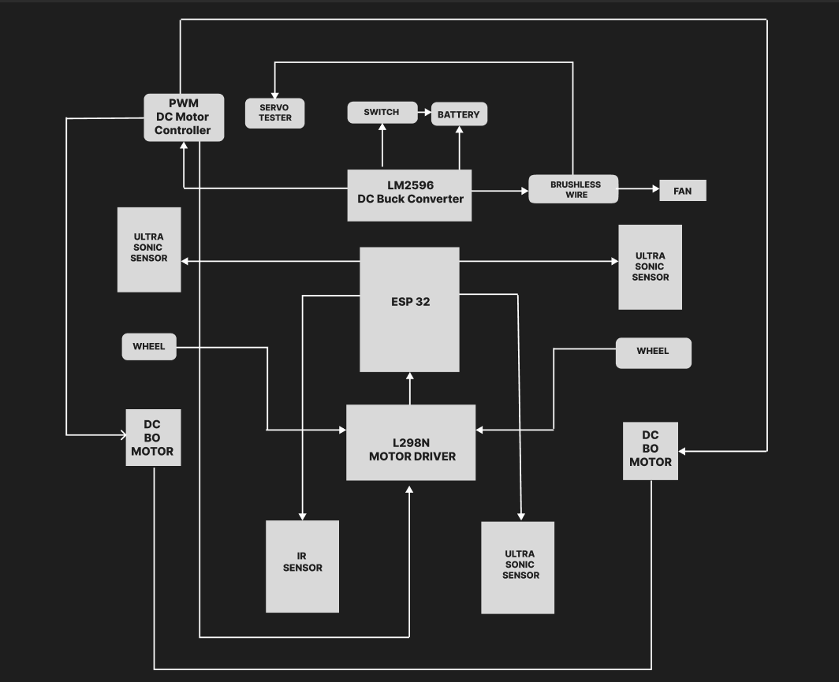
System Architecture

Slide 10
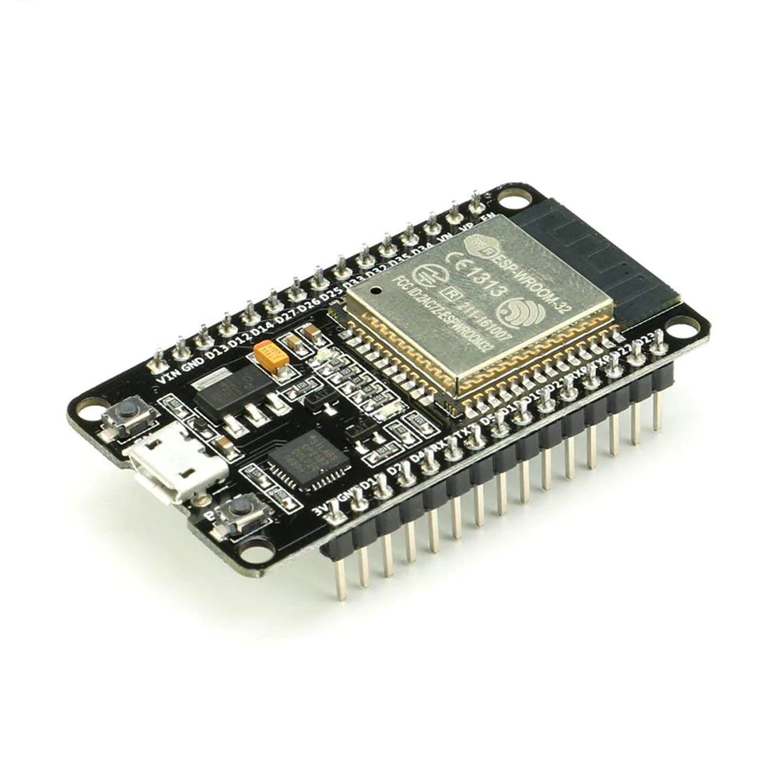
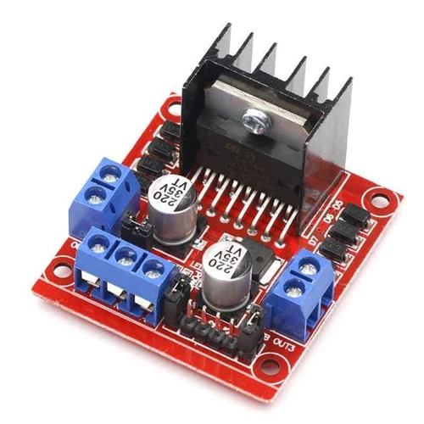
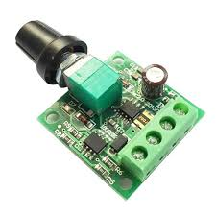
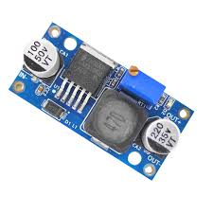
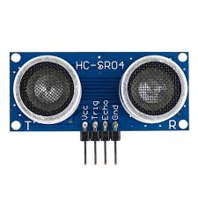
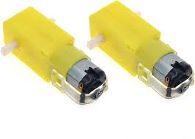
COMPONENTS USED
ESP 32 Microcontroller
L298N - Motor driver
PWM Speed Controller
DC-DC Buck Convertor
DC BO Motor
Ultrasonic Sensor

Slide 11
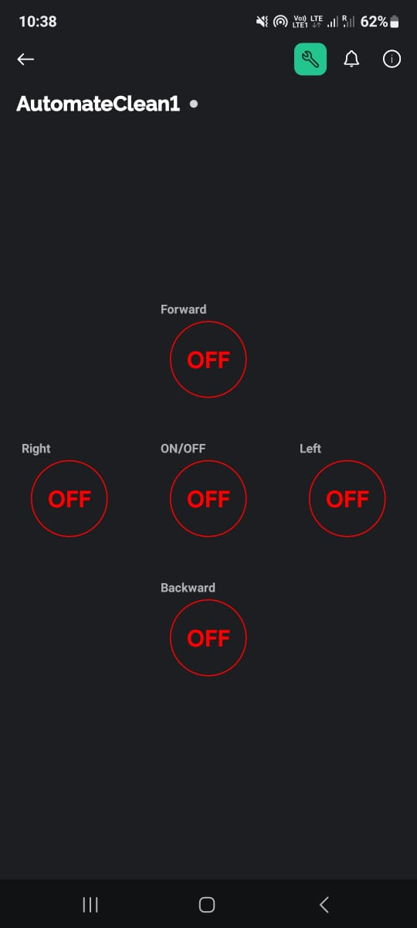
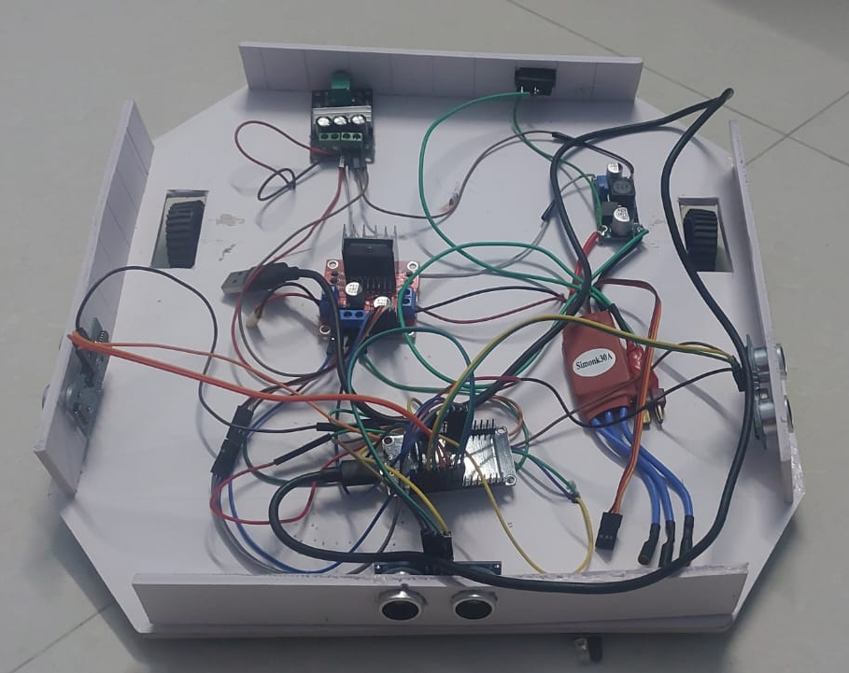
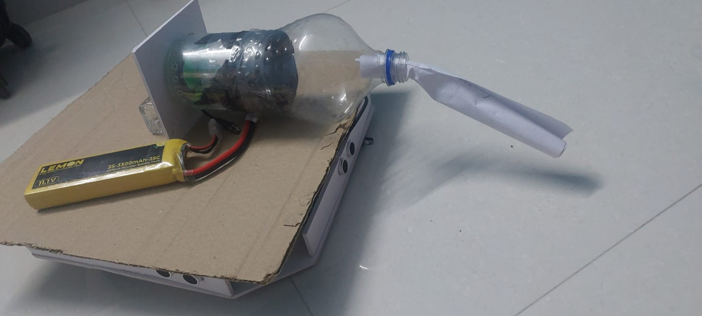
Output Screenshot
Fig : Dust Cleaning Bot
Fig : Blynk Integration

Slide 12
Conclusion
"Automate Clean” represents a significant step forward in the field of autonomous cleaning solutions. By leveraging robotic technology and IoT integration, the project addresses critical inefficiencies and safety concerns associated with traditional cleaning methods. The autonomous dust cleaning robot developed under this project promises to deliver high precision and effectiveness, making it an invaluable tool in maintaining cleanliness in large and hazardous areas. As the project continues to evolve, it will further solidify its role in transforming industrial and public space maintenance, contributing to safer and more efficient operations across various sectors.

Slide 13
Future Enhancement
Real-Time Path Optimization: Develop algorithms for real-time path optimization to improve coverage efficiency and reduce cleaning time.
Voice and Gesture Control: Implement voice and gesture recognition technologies for more natural and intuitive human-robot interactions.
Enhanced Hazard Detection: LiDAR can detect minute particles and changes in the environment, providing advanced warnings of potential hazards such as spills or debris that need immediate cleaning.

Slide 14
Reference Papers
Abhishek Pandey, Anirudh Kaushik, Amit Kumar Jha and Girish Kapse, "A Technological Survey on Autonomous Home Cleaning Robots", International Journal of Scientific and Research Publications, vol. 4, no. 4, April 2014.
PB Anusha, Disha Shetty, Reshma Marina D'Almeida and Shramika Chaithra Shetty, LABVIEW Operated Robotic Vacuum Cleaner” “International Journal of Internet of Things, vol. 6, no. 2, pp. 43-46, 2017.
"Smart Floor Cleaning Robot (CLEAR)", Ghulam Ishaq Khan Institute of Engineering Sciences and Technology Pakistan, 2015.
Namita Shinde, Shreya Shrivastava, Vineet Sharma and Samarth Kumar, "Paper on Arduino Controlled Arduino Based Robot Car", International Journal of Industrial Electronics and Electrical Engineering ISSN(p): 2347–6982, vol. 6, no. 3, March 2013.

